Slide 1

01
VISVESVARAYA TECHNOLOGICAL UNIVERSITY “Jnana Sangama”, Belagavi – 590018
VIVEKANANDA INSTITUTE OF TECHNOLOGY
BANGALORE-560074, Karnataka
DEPARTMENT OF COMPUTER SCIENCE & ENGINEERING
Phase2 Presentation On:
Face mask detection and face recognition using machine learning
Under the guidance of :
Ms. Poorvitha H R
Asst. Prof. Dept. of CSE, VKIT
Presented By:
Mizan Farooqui (1VK17CS032)
Prajwal S (1VK17CS039)
Roushan Raja (1VK17CS047)
Sudhanva Shrivallabha Pangari(1VK17CS061)
Presentation Date : 09-08-2021

Slide 2

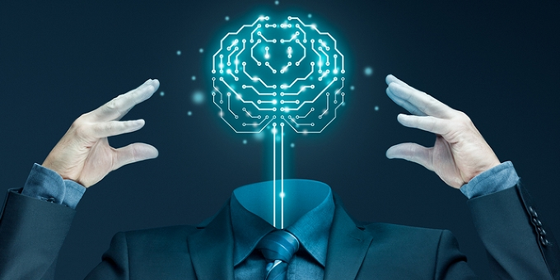
02
Face Mask Detection and Face Recognition Using Machine Learning
CONTENTS
ABSTRACT
INTRODUCTION
OBJECTIVES
LITERATURE SURVEY
EXISTING AND PROPOSED SYSTEM
METHODOLOGY
SYSTEM ARCHITECTURE
FLOW CHART
SYSTEM REQUIREMENTS
IMPLEMENTATION
CONCLUSION
REFERENCES
Dept of CSE, VKIT 2020-2021

Slide 3
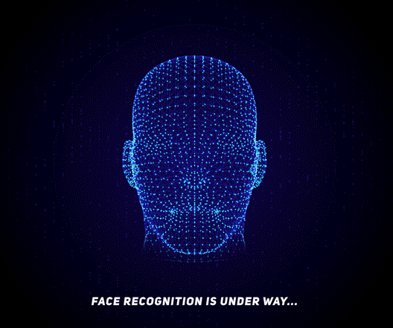
Face Mask Detection and Face Recognition Using Machine Learning
03
ABSTRACT
The major problem in Face detection
Image processing
Computer vision
Usage of convolutional neural networks with MobileNet V2
Detect Multiple Faces for mask in single frame.
Implementation Of Binary face classifier.
Recognizing the person identity who has been detected without mask.
Dept of CSE, VKIT 2020-2021

Slide 4



Face Mask Detection and Face Recognition Using Machine Learning
04
INTRODUCTION
Contents
Why we selected Face mask detection project
Abstract
Introduction
Existing System
Objectives
Literature Survey
Proposed System
Methodology
Hardware and Software Requirements
The unprecedented outbreak of the 2019 novel coronavirus, termed as COVID-19 by the World Health Organization (WHO), has placed numerous governments around the world in a precarious position.
Studies have proved that wearing a face mask significantly reduces the risk of viral transmission as well as provides a sense of protection.
By using face mask detection project we can detect faces in all public places.
Dept of CSE, VKIT 2020-2021

Slide 5
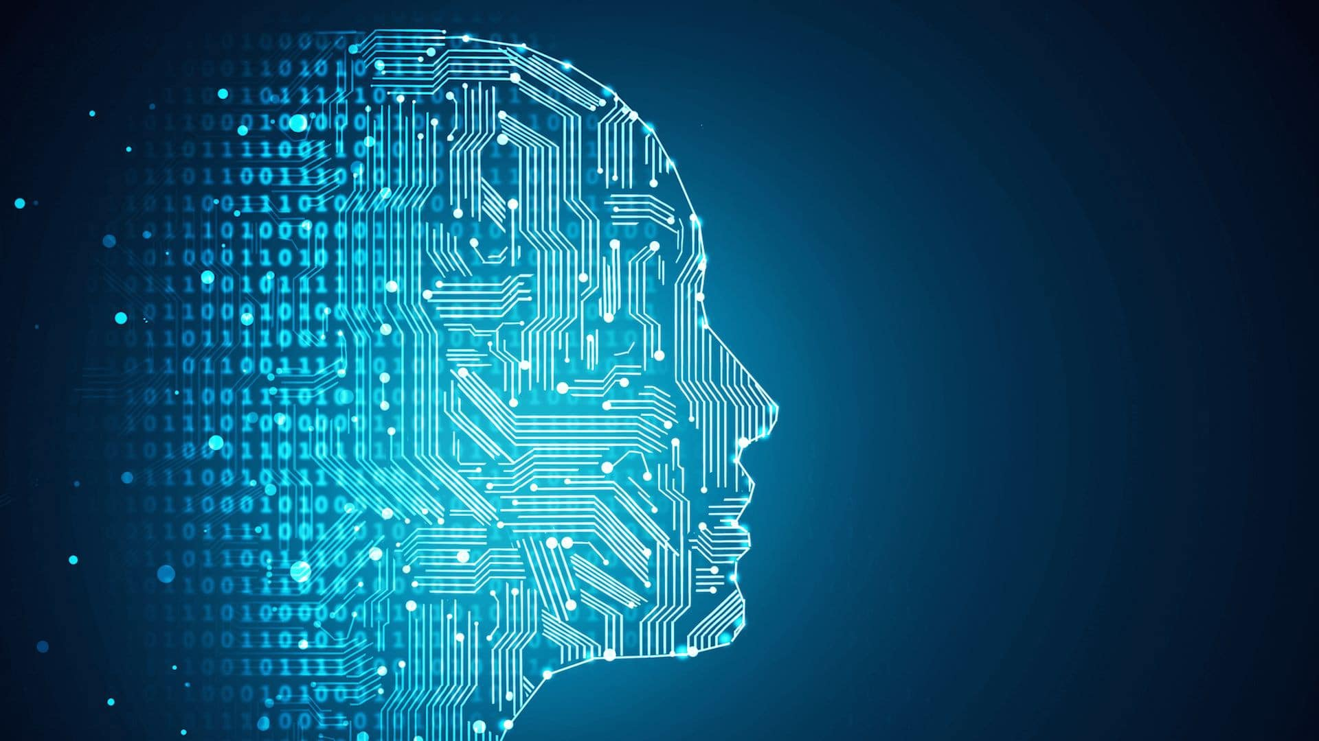
Face Mask Detection and Face Recognition Using Machine Learning
05
OBJECTIVES
We present a method to generate accurate face segmentation masks of any arbitrary size input image.
It is also able to detect facial masks in a single frame.
Combines the technology with face recognition to provide identity details of the person without mask.
Dept of CSE, VKIT 2020-2021

Slide 6
Face Mask Detection and Face Recognition Using Machine Learning
06
LITERATURE SURVEY
1. MULTI-STAGE CNN ARCHITECTURE FOR FACE MASK DETECTION, 2019
The Project propose a two-stage architecture for detecting masked and unmasked faces and localizing them.
Multi stage and single stage detectors.
CNN and RCNN algorithms.
Computer vision..
2. A FACEMASK DETECTOR USING MACHINE LEARNING AND IMAGE PROCESSING TECHNIQUES, 2020
The two best methodology is CNN and PCA with AAN.
Method:
Train deep learning model(MobileNetV2).
Apply face mask detector over images/live video stream.
Dept of CSE, VKIT 2020-2021

Slide 7
Face Mask Detection and Face Recognition Using Machine Learning
07
EXISTING SYSTEM
The existing system is used to detect the face in an image .
Binary face classifier is not implemented in the existing system.
PROPOSED SYSTEM
The Project is proposed with twin objective of creating a Binary face classifier which can recognize faces in any orientation irrespective of alignment and train it in an appropriate neural network to get accurate results.
The Proposed Project can detect the face and give the identity details of the person who has been detected without mask.
Dept of CSE, VKIT 2020-2021

Slide 8
Face Mask Detection and Face Recognition Using Machine Learning
08
METHODOLOGY
The Face Mask Recognition is developed with a machine learning methods such as Classification and Regression.
The study conducted its experiments on two original datasets.
The first dataset was taken from the With Mask dataset and Without Mask dataset used for the training, validation and testing phase.
The model can be produced by following some steps which are:
Data Collection
Pre- Processing
Split Dataset
Building the model
Testing and prediction model
Dept of CSE, VKIT 2020-2021

Slide 9
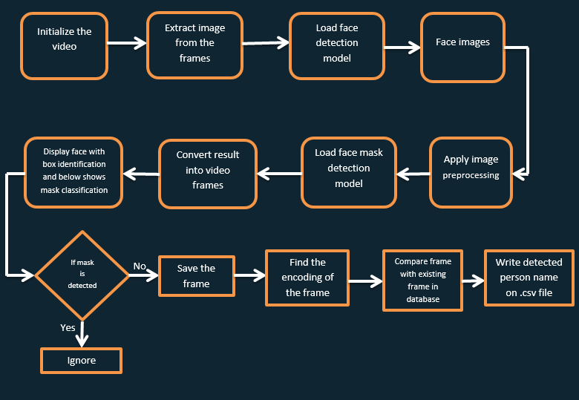
Face Mask Detection and Face Recognition Using Machine Learning
09
SYSTEM ARCHITECTURE
Dept of CSE, VKIT 2020-2021

Slide 10
Face Mask Detection and Face Recognition Using Machine Learning
10
FLOWCHART
DATA COLLECTION
PREPROCESSING
SPLIT DATA
BUILDING MODEL
TESTING MODEL
PREDICTING MODEL
Dept of CSE, VKIT 2020-2021

Slide 11
Face Mask Detection and Face Recognition Using Machine Learning
11
HARDWARE AND SOFTWARE REQUIREMENTS
HARDWARE REQUIREMENTS:
SOFTWARE REQUIREMENTS:
Processor : Pentium IV 2.4 GHz.
Hard Disk : 250 GB.
Monitor : 15 VGA Color.
RAM : 1 GB
Mouse : Optical
Keyboard : Multimedia
Operating system : Windows XP Professional / Windows7 or More
Coding Language : Python, MEAN Stack
IDE : PyCharm
Dept of CSE, VKIT 2020-2021

Slide 12


Face Mask Detection and Face Recognition Using Machine Learning
12
IMPLEMENTATION
DATA COLLECTION
The development of the Face mask detection model begins with collection of data.
The data set ,train data on people who use mask and who do not.
The model will differentiate between people wearing masks and not wearing masks.
Dept of CSE, VKIT 2020-2021

Slide 13
Face Mask Detection and Face Recognition Using Machine Learning
13
2. PRE-PROCESSING
The pre-processing phase is a phase before the training and testing of the data. These are steps in the pre-processing which are
Resizing image size.
Converting the image to the array.
Pre-processing input using MobileNet V2 architecture.
Dept of CSE, VKIT 2020-2021

Slide 14
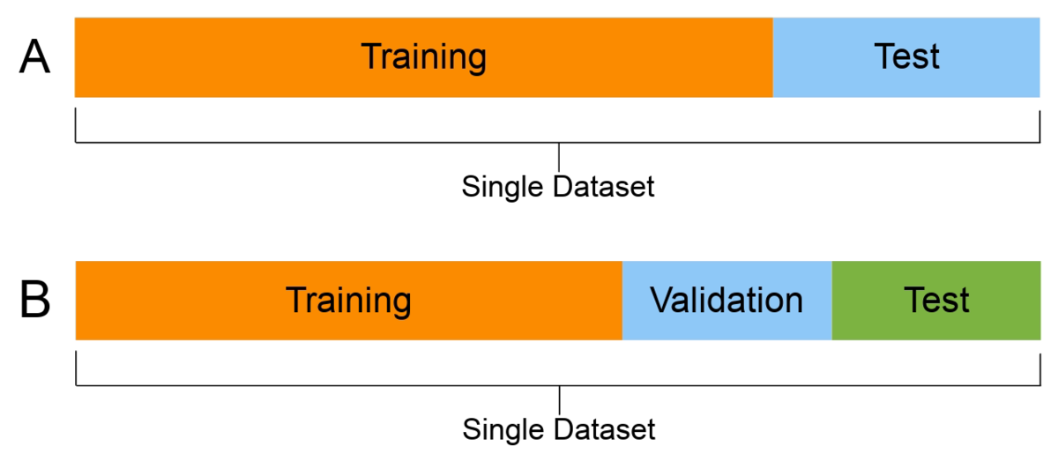
Face Mask Detection and Face Recognition Using Machine Learning
14
3. SPLIT THE DATA
After the pre- processing phase, the data is split into two batches, which are training data namely 75 percent and the rest is testing data.
Each batch is containing both of with-mask and without-mask images.
Dept of CSE, VKIT 2020-2021

Slide 15
Face Mask Detection and Face Recognition Using Machine Learning
15
4. BUILDING THE MODEL
There are six steps in building the model which are
Constructing the training image generator for augmentation.
The base model with Convolution Neural Network.
Adding model parameters.
Compiling the model.
Training the model.
Saving the model for the future prediction process.
Dept of CSE, VKIT 2020-2021

Slide 16
Face Mask Detection and Face Recognition Using Machine Learning
16
5. TESTING AND PREDICTING THE MODEL
To make sure the model can predict well, the first step is making predictions on the testing set.
Predicts the input data from the saved model.
Predict the input image that has been processed using a previously built model.
Validates if the Mask is Present or not.
Dept of CSE, VKIT 2020-2021

Slide 17
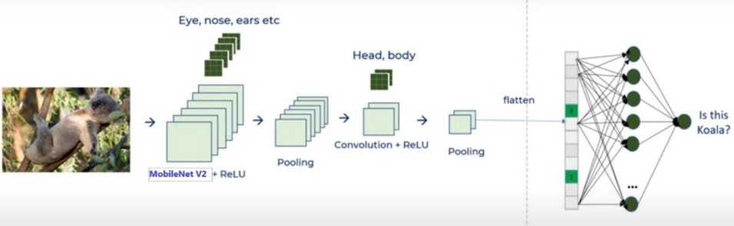
Face Mask Detection and Face Recognition Using Machine Learning
17
Convolutional Neural Network
Dept of CSE, VKIT 2020-2021

Slide 18
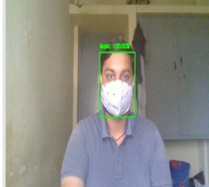
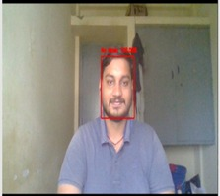
Face Mask Detection and Face Recognition Using Machine Learning
18
VALIDATION
1. SINGLE FACED FRAME
Fig 1: WITH MASK
Fig 2: WITHOUT MASK
Dept of CSE, VKIT 2020-2021

Slide 19
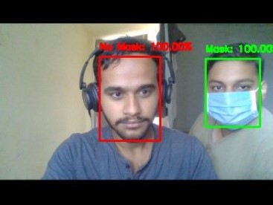
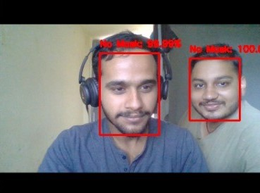
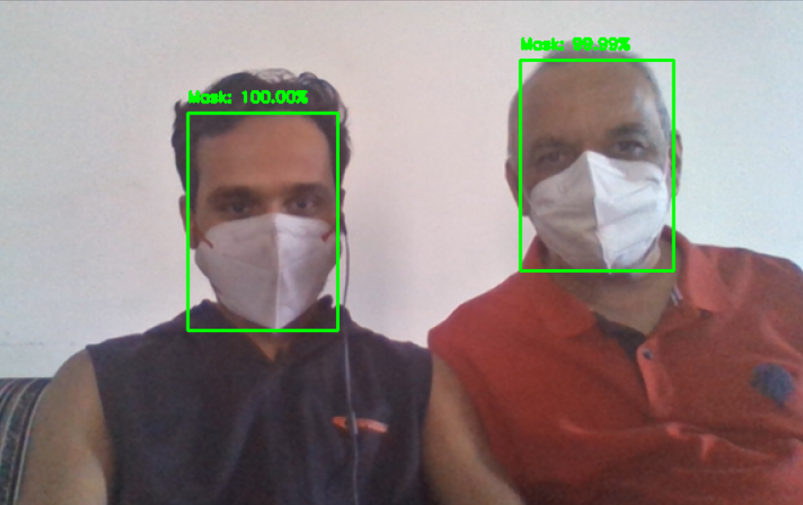
Face Mask Detection and Face Recognition Using Machine Learning
19
2. MULTIPLE FACED FRAME
Fig 3: Different Output of Multiple Faces in a single frame with and without mask
Dept of CSE, VKIT 2020-2021

Slide 20

Face Mask Detection and Face Recognition Using Machine Learning
20
USER INTERFACE
We have used MEAN Stack to develop the user interface.
M - MongoDB (Database)
E - Express Framework (Web Framework for node)
A - Angular Framework (User Interface)
N - Node Js (Backend Server)
Dept of CSE, VKIT 2020-2021

Slide 21

Face Mask Detection and Face Recognition Using Machine Learning
21
Fig 4: Main Page of the Application
Dept of CSE, VKIT 2020-2021

Slide 22

Face Mask Detection and Face Recognition Using Machine Learning
22
Fig 5: Mask Detection System Page
Dept of CSE, VKIT 2020-2021

Slide 23

Face Mask Detection and Face Recognition Using Machine Learning
23
Fig 6: Identity details of the people detected without mask
Dept of CSE, VKIT 2020-2021

Slide 24
Face Mask Detection and Face Recognition Using Machine Learning
24
CONCLUSION
Device can be able to generate accurate face masks for human objects from RGB channel images containing localized objects.
It demonstrated our results on Multi Human Parsing Dataset with mean pixel level accuracy.
Also, the problem of erroneous predictions has been solved and a proper bounding box has been drawn around the segmented region.
Proposed network can detect non frontal faces and multiple faces from single image.
The method can find applications in advanced tasks such as facial part detection.
Dept of CSE, VKIT 2020-2021

Slide 25
Face Mask Detection and Face Recognition Using Machine Learning
25
REFERENCES
T. Ojala, M. Pietikainen, and T. Maenpaa, “Multiresolution gray-scale and rotation invariant texture classification with local binary patterns,” IEEE Transactions on Pattern Analysis and Machine Intelligence, vol. 24, no. 7, pp. 971–987, July 2002
T.-H. Kim, D.-C. Park, D.-M. Woo, T. Jeong, and S.-Y. Min, “Multi-class classifier-based adaboost algorithm,” in Proceedings of the Second Sinoforeign-interchange Conference on Intelligent Science and Intelligent Data Engineering, ser. IScIDE’11. Berlin, Heidelberg: Springer-Verlag, 2012, pp. 122–127
P. Viola and M. J. Jones, “Robust real-time face detection,” Int. J. Comput. Vision, vol. 57, no. 2, pp. 137–154, May 2004
Dept of CSE, VKIT 2020-2021

Slide 26

PLEASE WEAR MASK AND MAINTAIN SOCIAL DISTANCING
THANK
YOU
STAY HOME, STAY SAFE

